Slide 1
Naïve Bayes Multi-label Classifier
Dr. Kavita S. Oza

Slide 2
Using 20newsgroups dataset
categories = ['alt.atheism', 'soc.religion.christian',
'comp.graphics', 'sci.med']
from sklearn.datasets import fetch_20newsgroups
twenty_train = fetch_20newsgroups(subset='train',
categories=categories, shuffle=True, random_state=42)
twenty_train.target_names
['alt.atheism', 'comp.graphics', 'sci.med', 'soc.religion.christian']
len(twenty_train.data)
2257

Slide 3
target names
twenty_train.target[:10]
array([1, 1, 3, 3, 3, 3, 3, 2, 2, 2], dtype=int64)
for t in twenty_train.target[:10]:
print(twenty_train.target_names[t])
comp.graphics
comp.graphics
soc.religion.christian
soc.religion.christian
soc.religion.christian
soc.religion.christian
soc.religion.christian
sci.med
sci.med
sci.med

Slide 4
CountVectorizer
from sklearn.feature_extraction.text import CountVectorizer
count_vect = CountVectorizer()
X_train_counts = count_vect.fit_transform(twenty_train.data)
X_train_counts.shape
(2257, 35788)

Slide 5
TfidfTransformer
from sklearn.feature_extraction.text import TfidfTransformer
tf_transformer = TfidfTransformer(use_idf=False).fit(X_train_counts)
X_train_tf = tf_transformer.transform(X_train_counts)
X_train_tf.shape
(2257, 35788)

Slide 6
Tfidfvectorizer
With Tfidftransformer ----compute word counts using CountVectorizer ----and then compute the IDF values and ----only then compute the Tf-idf scores.
With Tfidfvectorizer do all three steps at once.

Slide 7
Classifier
from sklearn.naive_bayes import MultinomialNB
tfidf_transformer = TfidfTransformer()
X_train_tfidf = tfidf_transformer.fit_transform(X_train_counts)
X_train_tfidf.shape
(2257, 35788)
nbClassifier = MultinomialNB()
nbClassifier.fit(X_train_tfidf, twenty_train.target)
MultinomialNB(alpha=1.0, class_prior=None, fit_prior=True)

Slide 8
Pipeline
from sklearn.pipeline import Pipeline
text_clf = Pipeline([
('vect', CountVectorizer()),
('tfidf', TfidfTransformer()),
('nbClassifier', MultinomialNB()),
])

Slide 9
Training the classifier
text_clf.fit(twenty_train.data, twenty_train.target)
Pipeline(memory=None, steps=[('vect', CountVectorizer(analyzer='word', binary=False, decode_error='strict', dtype=<class 'numpy.int64'>, encoding='utf-8', input='content', lowercase=True, max_df=1.0, max_features=None, min_df=1, ngram_range=(1, 1), preprocessor=None, stop_words=None, strip...False, use_idf=True)), ('nbClassifier', MultinomialNB(alpha=1.0, class_prior=None, fit_prior=True))])

Slide 10
Evaluating the classifier
import numpy as np
twenty_test = fetch_20newsgroups(subset='test',
categories=categories, shuffle=True,random_state=42)
docs_test = twenty_test.data
predicted = text_clf.predict(docs_test)
np.mean(predicted == twenty_test.target)
0.8348868175765646

Slide 11
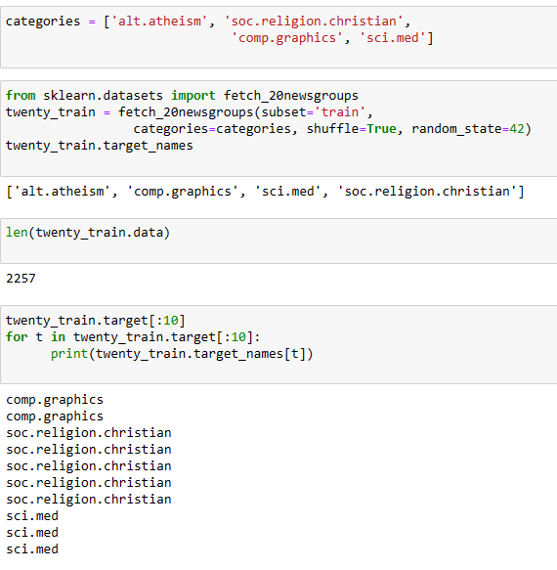
Program at a glance

Slide 12
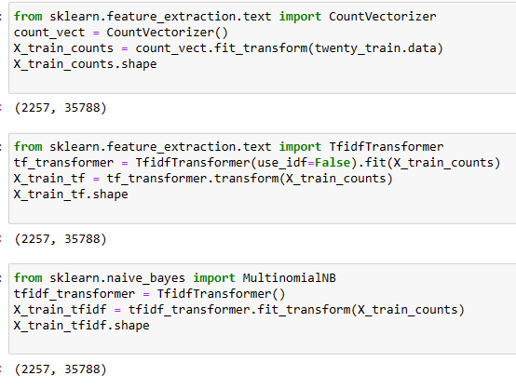
Program at a glance…

Slide 13
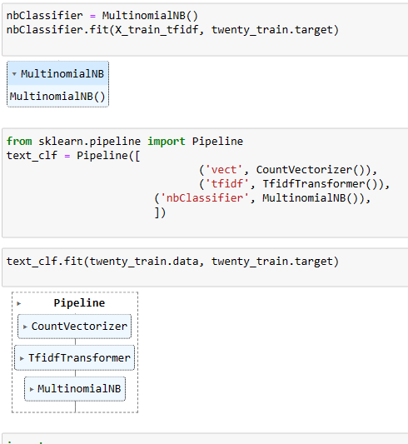
Program at a glance…

Slide 14
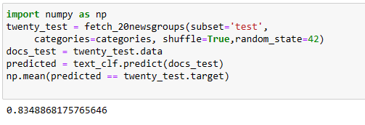
Program at a glance…

Slide 15
Thank You

